Slide 1
Optimising 3D-printed concrete structures for carbon capture and storage
Nataša Mitreva
Master student, Civil engineering
https://3dprintingindustry.com/news/peri-constructing-germanys-first-market-ready-3d-printed-residential-building-176638/
Notes:
20.05.2025
1

Slide 2


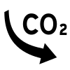
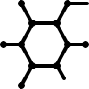
Challenge and possible solutions
Finding the best combination to minimize CO₂ emissions and maximize CO₂ removals while maintaining optimal structural strength and processability for 3D printing
Concrete mix design
Carbonation
Geometry
Reduce clinker (most emissive component)
Increase/ speed up CO2
removal
Reduce amount of concrete
Less concrete, less impact
BUT more strength, more impact
Decreases environmental impact
BUT can reduce the strength of concrete
By exposed increasing surface area, higher carbonation over time
By increasing CaO content
Natasa Mitreva
20/05/2025
2
Notes:
Porosity → water/cement ratio
FBS: I removed «of materials» from the first sentence because the best combinations also include the best geometries; we are not only looking at material selection. Reducing clinker content in cement and, therefore, in concrete, CAN reduce concrete strength, but if you replace clinker with other types of binders (supplementary cementitious materials like blast furnace slag, fly ash, calcined clay etc.), then the strength will not decrease or at least not decrease that much (this is why I put «can»). For carbonation, instead of presenting the structure like «YES/BUT», I suggest presenting the two strategies that can increase (or speed up) CO2 removal: we can increase the content of carbonatable material (CaO, which is linked with the concrete mix design); or increase the area exposed to carbonation (which is linked with the geometry). For the geometry, the main point of 3D-printing is to deposit materials only where needed, so I think we should mention it. This is why I suggest rephrasing it as «reduce amount of concrete», and then you have a yes/but situation: if you use less material you can have less impact, but you need more strength > higher cement content > higher emission per m3.
20.05.2025
2

Slide 3
Objectives
How can 3D-printed concrete structures be optimized to have a lower carbon footprint including the role of carbonation?
Specific Objectives
Develop a parametric model of CO₂ emissions and removals due to carbonation of 3DCP over time
Assess Global Warming Potential (GWP) using dynamic Life Cycle Assessment (LCA)
Define optimal parameters to reduce Global Warming Potential (GWP)
Natasa Mitreva
20/05/2025
3
Notes:
FBS: I suggest revising your objective to focus only on the 3D-printed concrete structures (which is how your model is structured now). I also suggest to be explicit about considering carbonation in the main objective.
20.05.2025
3

Slide 4


Parametric model – python code
01
Study Object
my python code
02
Geometry Definition
03
Calculation of cement content
04
Calculation of klinker content
05
Calculation of $CO_{2}$emissions
06
$CO_{2}$ removed by carbonation
07
Total Global Warming Potential
Natasa Mitreva
20/05/2025
4

Slide 5
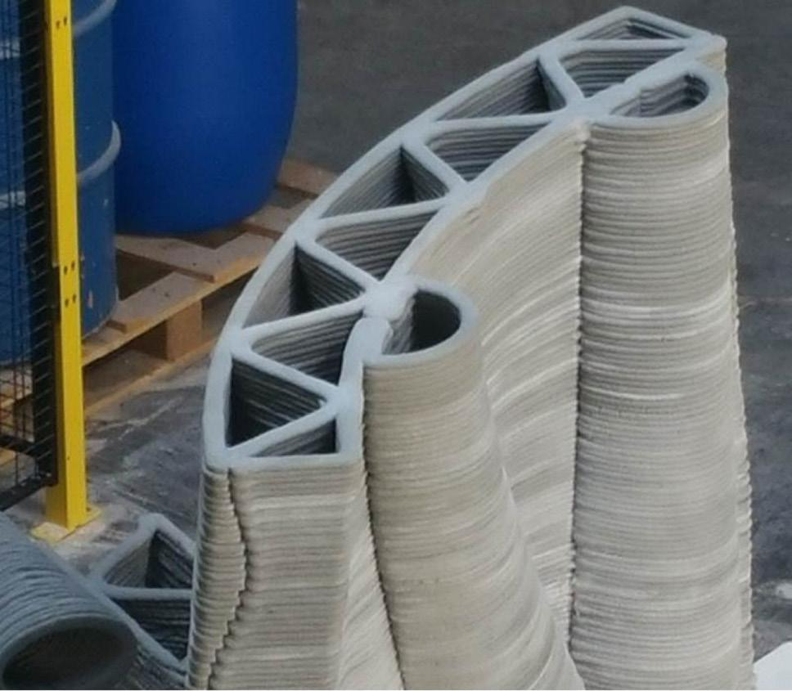
Study Object
Functional Unit
1 m² of 3D-printed wall
Designed to withstand a compressive load of 5 MN/m
Made of non-reinforced concrete
Service life: 60 years
Key Parameters
Concrete compressive strength: 30 MPa
Printing layer thickness: variable
Natasa Mitreva
20/05/2025
5
Notes:
FBS: you should mention that the load, compressive strength, and printing thickness are values that can be easily changed in your model; these are only one example. I added the service life as part of the functional unit too (it is important for the carbonation).
20.05.2025
5

Slide 6
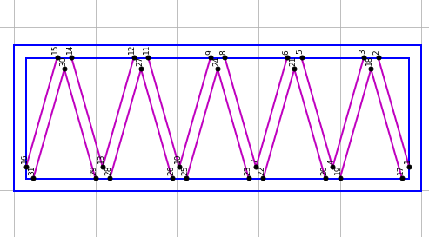
Geometry definition
Outer_length
Input
Number of triangles (min. 2)
Printing layer thickness
Output
Target cross-sectional area
Outer width (calculated iteratively)
Outer_width
Natasa Mitreva
20/05/2025
6

